Slide 1
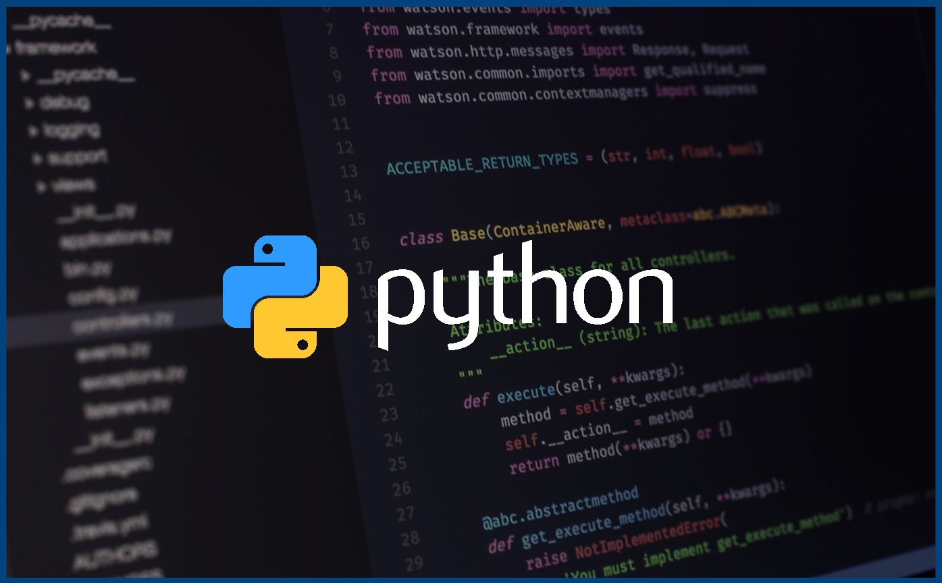
Introduction to Python!

Slide 2
What we’ve learned so far
Variables: strings, ints, floats, booleans
How to print, get user input
Math operators, built in functions
Lists, indexing, loops
Any questions about these
Do we want a refresh on anything?

Slide 3
1.
Dictionaries

Slide 4
Dictionaries
Data structure which holds a key-value pair
They are ordered, this means that we can turn them into lists
We can map keys by using for-loops
Let’s see an example
Dictionaries do not allow duplicate keys, but of course we can have duplicate values
Syntax: we use {} to define a dictionary
List of dictionary methods: https://www.w3schools.com/python/python_dictionaries_methods.asp

Slide 5
Dictionaries cont.
Dictionaries can contain any other data type, including other dictionaries
Dictionaries are iterable objects
Recall iterable objects from last week
We can use for loops to iterate over a dictionary
Let’s try another example, we’ll store a dictionary of players and their respective scores

Slide 6
2.
Functions

Slide 7
Functions:
Block of code which only runs when it is called
A function can take parameters as input to give data to a function
A function can return data as well
return keyword
The function can be assigned to a variable
Use the pass statement in an empty function

Slide 8
Arguments:
Information that are passed into a function.
def square(num):
num is a variable which is being used in the function
Keyword arguments:
We can give default values to a function if we want it to be optional
def power(num, power = 2):
When looking at python documentation:
Arguments: args
Keyword Arguments: kwargs

Slide 9
Return and Parameters
As mentioned, we can return values using the return keyword
We can specify the return type with an arrow
def do_something(num) -> int:
We can also specify an argument type
def do_something(num:int) -> int:

Slide 10
More Arguments :
We don’t need to know how many arguments are passed into a function
We can specify this with a *
This gives the function a list of arguments
Syntax Example:
def sum(*nums) int ->
We can also pass in an arbitrary number of keyword arguments
Use the syntax **
This passes the arguments as a dictionary

Slide 11
3.
Python Modules

Slide 12
Importing Modules.
Python has a number of built in modules that we can import into our program
Some of these include sys (which we’ve used), math, random
https://www.tutorialsteacher.com/python/python-builtin-modules
We can also make our own if we wanted that

Slide 13
Using the imports
We can use the functionality provided by these modules by calling the functions after its name
Syntax: math.exp(2, 2)
In python, there are a lot of modules which do what we want to do, its best to research if there already exists a module which does what we want before we write it
Math
Random
Sys
etc

Slide 14
4.
Practice

Slide 15
Exercise 1:
Let’s make a game
How about Rock, Paper, Scissors
We’ll make sure to practice with functions

Slide 16
Exercise 2:
Let’s build a simple game
Text-based adventure
Use user input to build a dynamic story
We will continue to cover this exercise next week, please work on this as homework and we can talk about it next week

